Slide 1

Image Captioning: A Fusion of LSTM and CNN
Image Captioning is the process of generating textual descriptions for images.
It combines computer vision to understand the image and natural language processing to generate the description.

Slide 2
Introduction to Image Captioning
1
Understanding Image Content
2
Descriptive Text Generation
Image captioning models learn to interpret the visual content of an image and convert it into meaningful text.
They generate captions that accurately describe the objects, actions, and relationships present in the image.
3
Applications
Image captioning finds applications in various domains, including image search, accessibility, and social media.

Slide 3

Applications of Image Captioning
Image Search
Accessibility
Social Media
Enhance search engine capabilities by enabling users to search using textual descriptions.
Provide visual descriptions for people with visual impairments, enhancing their access to information.
Automatically generate captions for images, improving user engagement and accessibility.

Slide 4
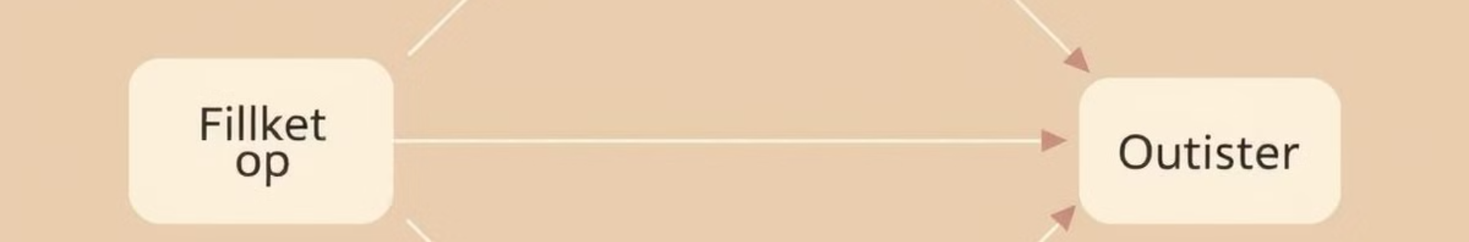
Fundamentals of Recurrent Neural Networks (RNNs) and Long Short-Term Memory (LSTMs)
1
2
3
RNNs: Sequential Data Processing
LSTMs: Addressing Vanishing Gradients
Language Modeling
In image captioning, LSTMs are used to generate coherent and grammatically correct captions.
RNNs excel at handling sequential data, capturing dependencies between elements in a sequence.
LSTMs, a specialized type of RNN, employ memory cells to retain information over long sequences, mitigating the vanishing gradient problem.

Slide 5

Convolutional Neural Networks (CNNs) for Image Understanding
Feature Extraction
Spatial Relationships
CNNs excel at extracting meaningful features from images like edges, shapes, and textures.
CNNs learn to understand spatial relationships between features, enabling image interpretation.
Image Representation
The output of a CNN provides a rich representation of the image, capturing key visual information.

Slide 6
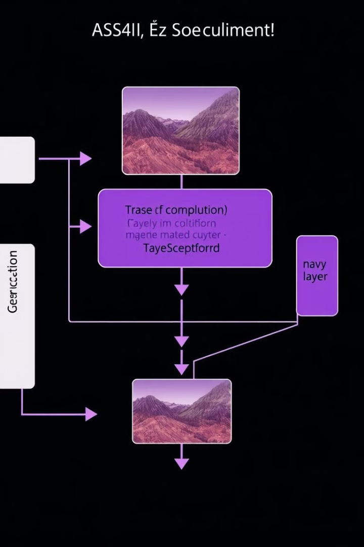



Integrating LSTM and CNN for Image Captioning
Image Input
The input image is fed into the CNN.
Feature Encoding
The CNN extracts features and encodes them into a vector representation.
Caption Generation
The LSTM processes the feature vector and generates a caption word by word.

Slide 7





Model Architecture and Training Process
CNN
1
Extracts features from the input image.
2
LSTM
Generates the caption based on encoded features.
3
Embedding Layer
Maps words to vectors for processing.
4
Training Data
Images paired with captions are used for training.
5
Loss Function
Measures the difference between predicted and actual captions.

Slide 8




Conclusion and Future Directions
Advancements
The fusion of LSTM and CNN has revolutionized image captioning.
Ongoing Research
Research continues to explore novel architectures, attention mechanisms, and training strategies.
Future Applications
Image captioning holds potential for accessibility tools, automated content generation, and advanced image search.

